Slide 1


Baseball II
Produced by Dr. Mario | UNC STOR 390

Slide 2



Pythagorean Theorem
WP = Win %
RS = Runs Scored
RA = Runs Allowed
Classic Pythagorean Theorem
Relationship Between the Sides of a Right Triangle
$a^{2}=b^{2}+c^{2}$
What is Known: More Runs = More Wins
Relationship Between Runs and Wins?
Bill James’ Pythagorean Method
Example: Kansas City in 2014 World Series
651 Runs Scored
624 Runs Allowed
$$WP≈ \frac{RS^{2}}{RS^{2}+RA^{2}}$$
$$89 Wins≈162× \frac{651^{2}}{651^{2}+624^{2}}=84.43$$

Slide 3



Pythagorean Theorem
WP = Win %
RS = Runs Scored
RA = Runs Allowed
Optimization of Relationship
What is the Best Choice of α?
Minimization of Sum of Squared Errors
Optimal: $α=1.82$
Alternative Expression
Useful for Forecasting Playoff Series Winners
Pythagorean Method: 53.8% Accurate
Games Won Approach: 50% Accurate
$$WP= \frac{RS^{α}}{RS^{α}+RA^{α}}+ε$$
#Blessed
$$WP= \frac{(R{S/RA)}^{α}}{(R{S/RA)}^{α}+1}+ε$$

Slide 4


Pythagorean Theorem
WP = Win %
RS = Runs Scored
RA = Runs Allowed
Useful for Valuing Players in Trades
Example: Cleveland Indians
Currently: RS=870 and RA=800
Trade Bing Crosby (100 Runs)
For Frank Sinatra (120 Runs)
Difference: +20 Runs
Before Trade:
After Trade:
$$WP≈ \frac{{\left(\frac{870}{800}\right)}^{1.82}}{{\left(\frac{870}{800}\right)}^{1.82}+1}=0.538$$
$$WP≈ \frac{{\left(\frac{890}{800}\right)}^{1.82}}{{\left(\frac{890}{800}\right)}^{1.82}+1}=0.548$$

Slide 5
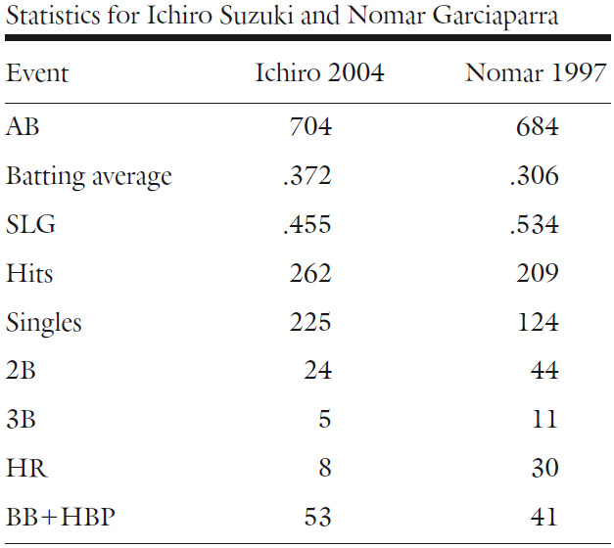
Runs-Created Approach
Motivation: Nomar Vs. Ichiro

Slide 6
Runs-Created Approach
H = Hit
S = Single
D = Double
T = Triple
HR = Home Run
AB = At-bat
BB = Walk
HBP = Hit-by-Pitch
Argument
Hitting Causes Good and Bad Things
Hits and Walks Create Scoring Opportunities
Better Hitter = More Scoring Opportunity
Relationship of Runs and {S,D,T,HR,BB,HBP}
Runs-Created Formula
Bill James (1979)
Recall: Total Bases (TB)
Formula:
$$TB≈S+2D+3T+4HR$$
$$RC≈\left(H+BB+HBP\right)×\frac{TB}{AB+BB+HBP}$$
# of Base Runners
Rate Players are Advancing

Slide 7

Runs-Created Approach
y = Actual Runs
y = Predicted Runs
n = Sample Size
Evaluation of Runs Created Formula
Mean Percentage Error (MPE)
Formula for MPE:
Based off Formula for RC, MPE = 4%
Problem: Formula Developed Off Team Statistics
Results
$$MPE=\frac{100\%}{n}×\sum_{i=1}^{n}{\frac{y_{i}−\hat{y_{i}}}{y_{i}}}$$
Model Based On Teams
Predict on Players
Playa and Year | Runs Created
Ichiro 2004 | 133.16
Nomar 1997 | 125.86
Bonds 2004 | 185.74

Slide 8

Runs-Created Approach
RC = Runs Created
AB = At-bat
E = Errors
H = Hits
TO = Total Outs
GIDP = Double-Play
SF = Sacrifice Fly
SAC = Sacrifice Bunt
CS = Caught Stealing
Runs Created Per Game
RC Flaw= Biased Toward Plate Appearances
Observation 1: 1.8% of AB are E
Observation 2: Additional Outs Caused by GIDP, SF, SAC, and CS
Observation 3: Sometimes 27 Outs Per Game
Observation 4: Following in Units of Game
$AB−H−\left(0.018\right)AB=\left(0.982\right)AB−H$
$TO=\left(0.982\right)AB−H+GIDP+SF+SAC+CS$
$$Average Outs Per Game=26.72$$
$$\frac{TO}{26.72}$$

Slide 9


Runs-Created Approach
RC = Runs Created
AB = At-bat
E = Errors
H = Hits
TO = Total Outs
GIDP = Double-Play
SF = Sacrifice Fly
SAC = Sacrifice Bunt
CS = Caught Stealing
Runs Created Per Game
Final Formula for RC/G
Interpretation of RC/G
Results Updated
$$\frac{RC}{G}=\frac{RC}{\frac{TO}{26.72}}$$
$$\frac{RC}{G}=\frac{Runs Created by Batter}{\# of Games Worth of Outs Used by Batter}$$
Playa and Year | RC | RC/G
Ichiro 2004 | 133.16 | 7.88
Nomar 1997 | 125.86 | 6.72
Bonds 2004 | 185.74 | 20.65

Slide 10

America’s Greatest Pastime

Slide 11
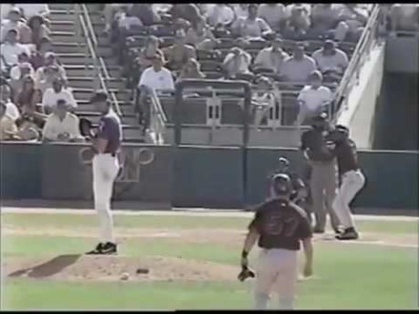
America’s Greatest Pastime

Slide 12

Final Inspiration
Well, it took me 17 years to get 3,000 hits in baseball, and I did it in one afternoon on the golf course.
- Hank Aaron

